Slide 1
ECE 5397/6397:
Introduction to Robotics
Lecture 10:
Introduction to angular velocity, skew symmetric matrices
Reference: Chapter 4.1-4.3, RD&C
Instructor: Aaron Becker

Slide 2
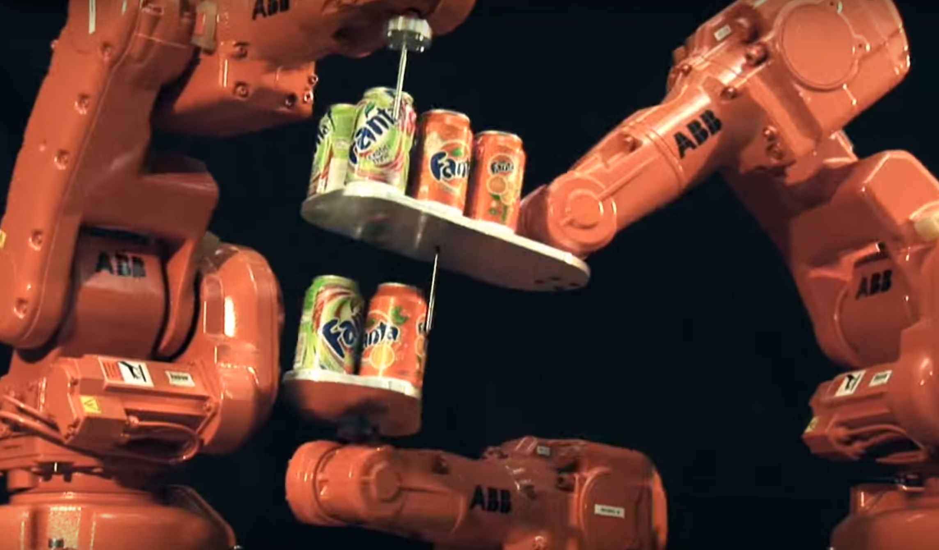
Why do we need velocity control?
https://www.youtube.com/watch?v=SOESSCXGhFo

Slide 3

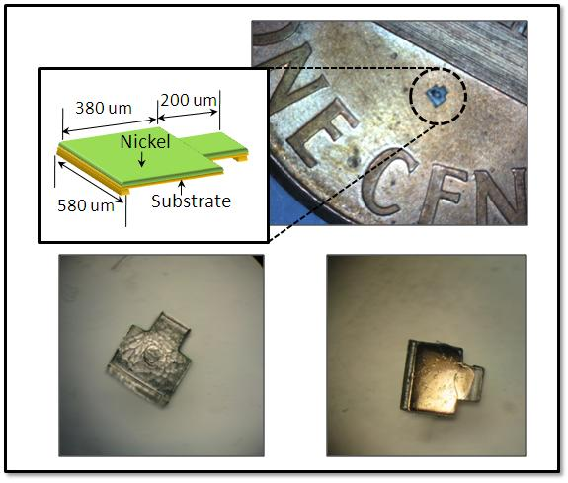
David Cappelleri, Multi-Scale Robotics and Automation
David J. Cappelleri is an Assistant Professor in the School of Mechanical Engineering at Purdue University. Prior to joining Purdue, he was an Assistant Professor in the Department of Mechanical Engineering at Stevens Institute of Technology, Hoboken, NJ. Prof. Cappelleri founded the Multi-Scale Robotics & Automation Lab that performs cutting-edge research on robotic and automation systems at various length scales: macro-scale (cm to m), meso-scale (~100’s of um to a few mm’s), micro-scale (10’s of um to 100’s of um), and nano-scale (nm).
Notes:
Teleoperators from WWII to handle radioactive materials
CNC developed because of high precision required to machine certain items

Slide 4
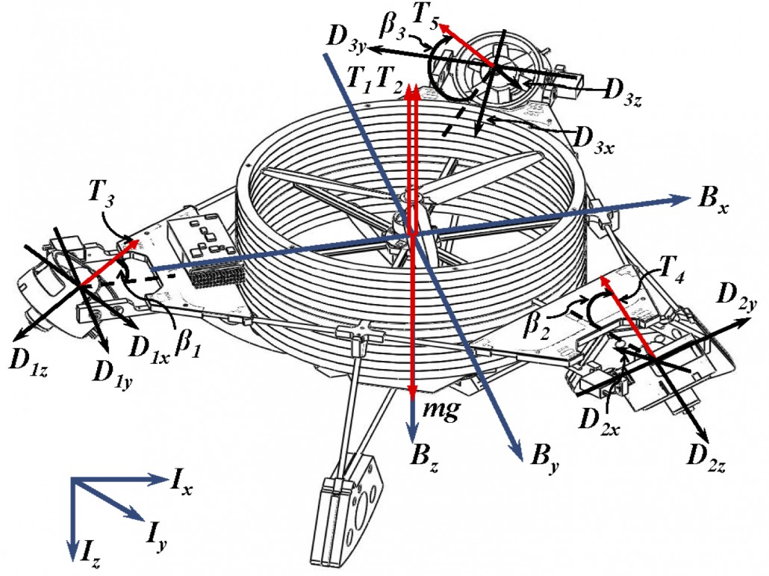
Autonomous Micro Aerial Vehicles
design and control of autonomous micro aerial vehicles in unknown, cluttered environments. Applications: from search-and-rescue, security, surveillance, mapping, and remote sensing. Traditional vertical take-off and landing micro aerial vehicles are generally underactuated, i.e., equipped with fewer actuators than degrees-of-freedom. As a consequence, they possess a limited mobility because of their inherent underactuation (e.g., quadorotor helicopters can neither translate laterally with a zero attitude nor hover at a spot with a nonzero attitude). We would like a MAV to hover in place with any body orientation and be able to translate with a zero attitude. Additionally, we want to be able to arbitrarily orient a sensor or gripper attached to the MAV body during flight.

Slide 5
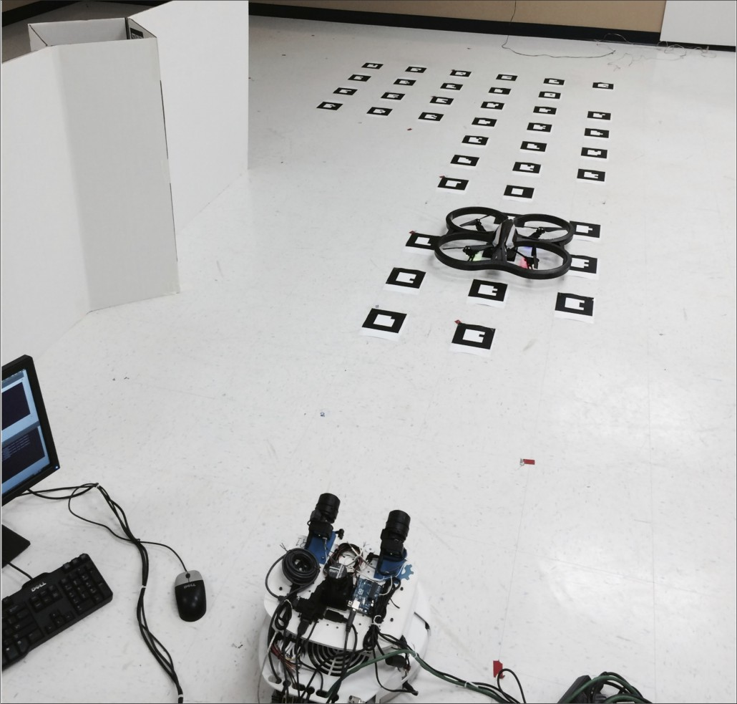
Heterogeneous Multi-Robot Teams
Complicated tasks may be too difficult for a single robot to accomplish alone or a team of homogenous robots to dexterously accomplish. Thus, coordination of a heterogeneous team of robots can allow the completion of a complicated task that a team of only one sub-group would be incapable of achieving. For example, aerial robots exhibit several advantages over ground robots, including the ability to maneuver through complex three-dimensional environments and gather data from vantages inaccessible to ground robots. However, aerial robots also have several limitations that reduce their applicability, such as the need for wireless communication and a limited onboard power supply that restricts the platform’s payload capacity and flying time. On the other hand, ground robots can carry large payloads and requisite computing power and communications hardware.

Slide 6
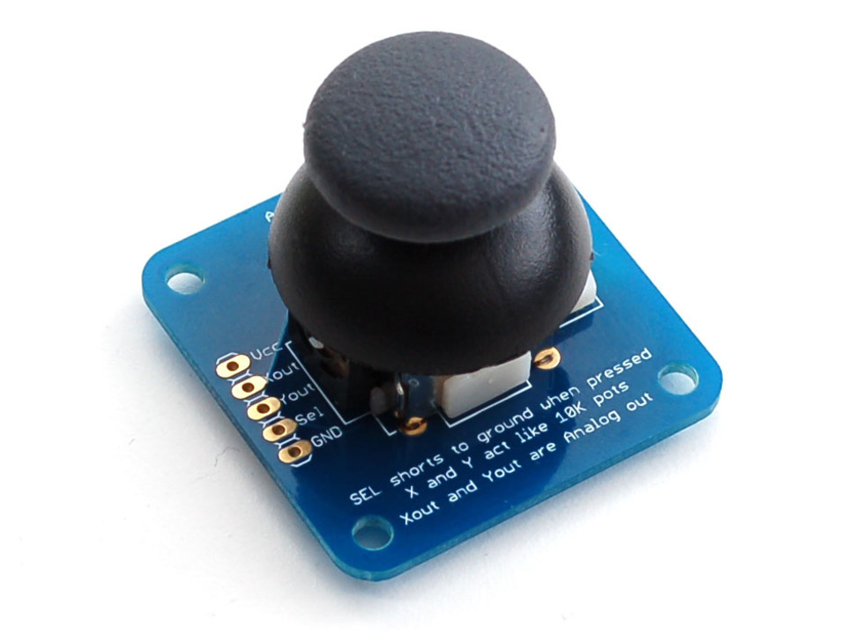
Outreach Next Tuesday, 10 am
Outreach lesson at https://github.com/UH-ECE6397/Class-Materials/tree/master/RobotArm/outreach ($200 prize for best swarmathon outreach description)
Arms inverse kinematics at https://github.com/yorkhackspace/meArm
(to add an arduino library: To load libraries: https://www.arduino.cc/en/Guide/Libraries
Up to 5% extra credit for a good Arduino GUI that controls all four servos using sliders, and allows setting max and min values for each servo
All components are in lab (400 12mm screws), new rubber feet
I’m buying a few joysticks for demo versions of the arm https://www.adafruit.com/products/512
Notes:
To load libraries: https://www.arduino.cc/en/Guide/Libraries

Slide 7
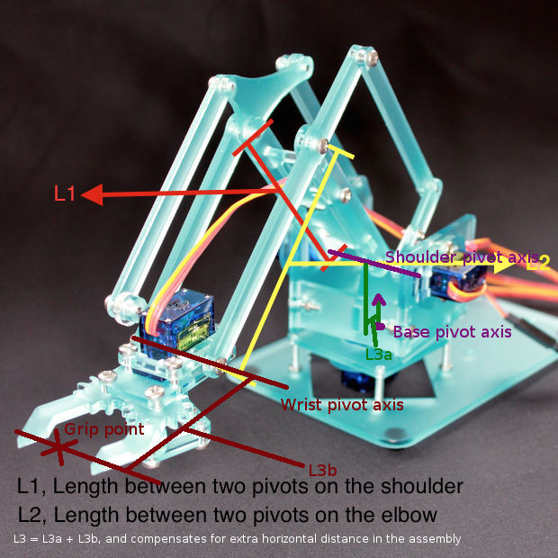
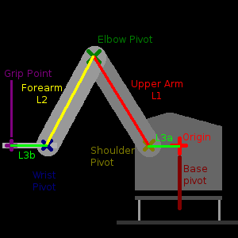
DH parameters, MeARM
Notes:
This is a description of how to set up L1, L2 and L3 if you use a different sized arm.
The algorithm needs a point of reference (the origin) to refer to things with, which I chose to place directly above the axis the arm rotates around at the base - as this never moves. Specifically, the point is directly above the base servo, at the same height as the shoulder servo.
From this point, there are four steps (vectors) to get to the gripper:
- Go forward to reach the shoulder (L3a)
- Follow the angle of the upper arm to get to the elbow (L1)
- Follow the angle of the forearm to get to the wrist (L2)
- Go forward to reach the front of the gripper (L3b)
Because the first and last steps are in the same direction, I chose to combine them. Here's a diagram that might help:
![mearm-geometry](https://cloud.githubusercontent.com/assets/6117158/11512378/b7a06b70-9865-11e5-8bb8-f9adf5963b04.png)
Here's an annotated a photo in case the diagram isn't clear enough (thanks to nihabe). L3a and L3b are easiest to understand if you look at the arm side-on, as L3 is accounting for extra horizontal distance in the assembly.
There are two rotations happening near the base - one horizontally, to swing the arm left and right (the base pivot axis) and one vertical, to lift and lower the arm (the shoulder pivot axis). L3a is the front-to-back distance between these - basically, how far forward is the centre of the shoulder servo compared to the centre of the base servo.
At the wrist end, the algorithm has to account for the size of the gripper. The two interesting points here are the wrist pivot axis (where the arm meets the horizontal "hand" part), and the point where the grips meet when they close (where they'd pick something up). L3b is the distance between these - basically, how far forward is the point being gripped compared to the wrist.
![1d0f3ccc-97ba-11e5-8b4c-a264fb9dacd7](https://cloud.githubusercontent.com/assets/6117158/11508922/207223e0-9853-11e5-9ac8-e028037a1891.jpg)

Slide 8
DH frame for MeArm

Slide 9
DH frame for MeArm

Slide 10
Jacobian
Jac·o·bi·an jəˈkōbēən/
MATHEMATICS
Adjective
of or relating to the work of the mathematician K. G. J. Jacobi.
Noun
a determinant whose constituents are the derivatives of a number of functions ( u,v, w, …) with respect to each of the same number of variables ( x, y, z, …).

Slide 11
Jacobian
Forward kinematics define function from
joint variables to Cartesian position and orientation
Jacobian of this function gives velocity relationships
Jacobian important:
For planning & executing smooth trajectories
Determining singular configurations
Execution coordinated anthropomorphic motion
Deriving dynamics equations of motion
Transform forces and torques at end-effector to the manipulator joints

Slide 12
outline
Velocities, how to represent
Angular velocites (need ‘skew symmetric’)
Rotation about fixed axis
General: rotation about moving axis
Derive equations for angular and linear velocity of moving frame
Derive manipulator Jacobian, instantaneous transformation from n-vector of joint velocities to 6-vector of linear & angular velocities of end effector

Slide 13
Rotation
Notes:
On board

Slide 14
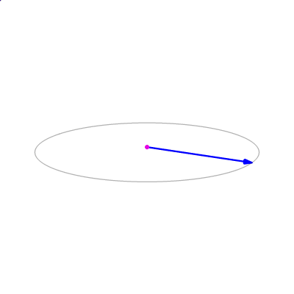
Cross product: A x B = |A||B|sinθ n
Notes:
https://en.wikipedia.org/wiki/Cross_product

Slide 15
For the Next Class
Study Ch. 4.4-4.6 for Lecture 11
https://www.arduino.cc/en/Guide/Libraries

Slide 16
In class worksheet

